Slide 1

BEFORE TRANSLATION
THE BRIDE WILL HAVE A TESTIMONY THAT SHE PLEASED THE LORD
WEDNESDAY 29TH JANUARY 2025
Notes:
Daniel Chapter 1 deals with Nebuchadnezzar goes to Jerusalem and besiege it (surround it that no one come out of the city)
This is where we see his vision sweeps the whole course of Gentile world-rule to its end in catastrophe and to the setting up of the Messianic kingdom.
when the stone which was cut without hands becomes a mountain that fills the whole earth.

Slide 2


Hebrews 11:5 - 6
5. By faith [that pleased God] Enoch was translated that he should not see death; and was not found, because God had translated him: for before his translation he had this testimony, that he pleased God
6 But without faith it is impossible to please him: for he that cometh to God must believe that he is, and that he is a rewarder of them that diligently seek him
Notes:
Chapter 2 begins with the Dream of Nebuchadnezzar.
- A decree went fourth that all the wise should be slain and that included Daniel and some of his people that were wise
Daniel goes into prayer where he finds favour with God to see this dream and the interpretation thereof.
I like the respond of Daniel which everyone should learn of
27. Daniel answered in the presence of the king, and said, The secret which the king hath demanded cannot the wise men, the astrologers, the magicians, the soothsayers, shew unto the king

Slide 3
281 There’s others that did the same thing. Look at Enoch. He walked with God for five hundred years, and then he had a testimony that “He pleased God.” God had verified it, and said, “There’s no need of you dying, just come on up Home this afternoon.” And he went up.
65-1207 - LEADERSHIP
Notes:
Before we go into scripture let's have a look at what the prophet says to lay the foundation...
6 Now, Daniel was one of the prophet that was carried from Jerusalem, down into Babylon, in the carrying away of Babylon, by King Nebuchadnezzar. He was a young fellow when he went down into Babylon.
3. And the king spake unto Ashpenaz the master of his eunuchs, that he should bring certain of the children of Israel, and of the king's seed, and of the princes;
4. Children in whom was no blemish, but well favoured, and skilful in all wisdom, and cunning in knowledge, and understanding science, and such as had ability in them to stand in the king's palace, and whom they might teach the learning and the tongue of the Chaldeans.

Slide 4
173 Let’s take another man with this quickening power. There was a man way long ago, by the name of Enoch. When a new thing come along, when something come along and said, “Well, now we have to go back to the old school, or this, that, or the other,” Enoch walked with God. Whatever God said do, Enoch never missed one Word. He walked with God. What was he? He was a son of God. He was an eagle that had been called to that day.
65-0410 - THE EASTER SEAL
Notes:
Before we go into scripture let's have a look at what the prophet says to lay the foundation...
6 Now, Daniel was one of the prophet that was carried from Jerusalem, down into Babylon, in the carrying away of Babylon, by King Nebuchadnezzar. He was a young fellow when he went down into Babylon.
3. And the king spake unto Ashpenaz the master of his eunuchs, that he should bring certain of the children of Israel, and of the king's seed, and of the princes;
4. Children in whom was no blemish, but well favoured, and skilful in all wisdom, and cunning in knowledge, and understanding science, and such as had ability in them to stand in the king's palace, and whom they might teach the learning and the tongue of the Chaldeans.

Slide 5
174 And when come time, he was so full of that quickening power! Remember, he had walked five hundred years, or more, before God, and not one time had he missed His Word. Not one time did he misbehave himself. Not one time did he do but kept the testimony. Everything that God told him to do, he went and done it.
65-0410 - THE EASTER SEAL
Notes:
Before we go into scripture let's have a look at what the prophet says to lay the foundation...
6 Now, Daniel was one of the prophet that was carried from Jerusalem, down into Babylon, in the carrying away of Babylon, by King Nebuchadnezzar. He was a young fellow when he went down into Babylon.
3. And the king spake unto Ashpenaz the master of his eunuchs, that he should bring certain of the children of Israel, and of the king's seed, and of the princes;
4. Children in whom was no blemish, but well favoured, and skilful in all wisdom, and cunning in knowledge, and understanding science, and such as had ability in them to stand in the king's palace, and whom they might teach the learning and the tongue of the Chaldeans.

Slide 6
174 .. No argument about it, he just went and done it. No matter what anybody else thought, he went and done it. Why? He was full of that quickening power. And when it come time for the old man to die, God just sent down the ladder and he walked up Home. He quickened him, and took his mortal body up in a rapture. Amen. That’s that quickening power.
65-0410 - THE EASTER SEAL
Notes:
Before we go into scripture let's have a look at what the prophet says to lay the foundation...
6 Now, Daniel was one of the prophet that was carried from Jerusalem, down into Babylon, in the carrying away of Babylon, by King Nebuchadnezzar. He was a young fellow when he went down into Babylon.
3. And the king spake unto Ashpenaz the master of his eunuchs, that he should bring certain of the children of Israel, and of the king's seed, and of the princes;
4. Children in whom was no blemish, but well favoured, and skilful in all wisdom, and cunning in knowledge, and understanding science, and such as had ability in them to stand in the king's palace, and whom they might teach the learning and the tongue of the Chaldeans.

Slide 7
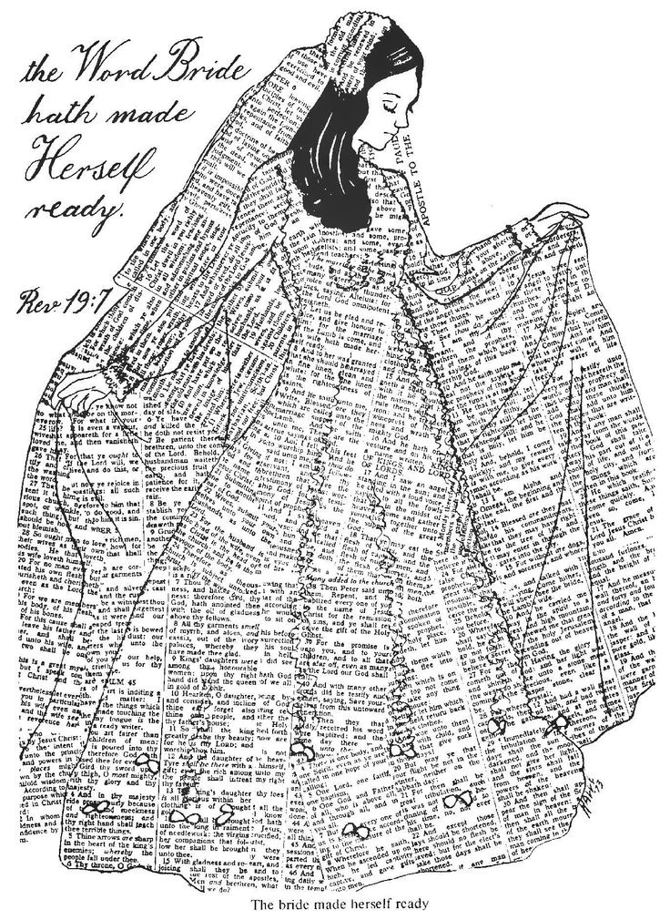
She pleased the Lord

Slide 8
Genesis 5: 18 – 21
18 And Jared lived an hundred sixty and two years, and he begat Enoch:
19 And Jared lived after he begat Enoch eight hundred (800) years, and begat sons and daughters:
20 And all the days of Jared were nine hundred sixty and two (962) years: and he died.
21 And Enoch lived sixty and five years (65), and begat Methuselah:
Notes:
Chapter 2 begins with the Dream of Nebuchadnezzar.
- A decree went fourth that all the wise should be slain and that included Daniel and some of his people that were wise
Daniel goes into prayer where he finds favour with God to see this dream and the interpretation thereof.
I like the respond of Daniel which everyone should learn of
27. Daniel answered in the presence of the king, and said, The secret which the king hath demanded cannot the wise men, the astrologers, the magicians, the soothsayers, shew unto the king

Slide 9
Genesis 5: 22 – 24
22 And Enoch walked with God after he begat Methuselah three hundred years (300), and begat sons and daughters:
23 And all the days of Enoch were three hundred sixty and five years:
24 And [in reverent fear and obedience] Enoch walked with God: and he was not; for God took him.
Notes:
Chapter 2 begins with the Dream of Nebuchadnezzar.
- A decree went fourth that all the wise should be slain and that included Daniel and some of his people that were wise
Daniel goes into prayer where he finds favour with God to see this dream and the interpretation thereof.
I like the respond of Daniel which everyone should learn of
27. Daniel answered in the presence of the king, and said, The secret which the king hath demanded cannot the wise men, the astrologers, the magicians, the soothsayers, shew unto the king

Slide 10
Genesis 5: 22 – 24
22 And Enoch walked with God after he begat Methuselah three hundred years (300), and begat sons and daughters:
23 And all the days of Enoch were three hundred sixty and five years:
24 And [in reverent fear and obedience] Enoch walked with God: and he was not; for God took him.
Notes:
Chapter 2 begins with the Dream of Nebuchadnezzar.
- A decree went fourth that all the wise should be slain and that included Daniel and some of his people that were wise
Daniel goes into prayer where he finds favour with God to see this dream and the interpretation thereof.
I like the respond of Daniel which everyone should learn of
27. Daniel answered in the presence of the king, and said, The secret which the king hath demanded cannot the wise men, the astrologers, the magicians, the soothsayers, shew unto the king

Slide 11
Colossians 3: 1 - 4
1 If ye then be risen with Christ, seek those things which are above, where Christ sitteth on the right hand of God.
2 Set your affection on things above, not on things on the earth.
3 For ye are dead, and your life is hid with Christ in God.
4 When Christ, who is our life, shall appear, then shall ye also appear with him in glory.
Notes:
Chapter 2 begins with the Dream of Nebuchadnezzar.
- A decree went fourth that all the wise should be slain and that included Daniel and some of his people that were wise
Daniel goes into prayer where he finds favour with God to see this dream and the interpretation thereof.
I like the respond of Daniel which everyone should learn of
27. Daniel answered in the presence of the king, and said, The secret which the king hath demanded cannot the wise men, the astrologers, the magicians, the soothsayers, shew unto the king

Slide 12
31 Very beautiful type of today, also. As the evil is appearing, so is good appearing.
32 And notice back there in that evil day, just before the destruction, when God had a man out preaching the Gospel, a poor man, humble man, not very much of the world, but a man who had a heart to listen to God; Noah. There was Noah and Enoch, preaching, at the same time.
56-0115 - THE JUNCTION OF TIME
Notes:
Before we go into scripture let's have a look at what the prophet says to lay the foundation...
6 Now, Daniel was one of the prophet that was carried from Jerusalem, down into Babylon, in the carrying away of Babylon, by King Nebuchadnezzar. He was a young fellow when he went down into Babylon.
3. And the king spake unto Ashpenaz the master of his eunuchs, that he should bring certain of the children of Israel, and of the king's seed, and of the princes;
4. Children in whom was no blemish, but well favoured, and skilful in all wisdom, and cunning in knowledge, and understanding science, and such as had ability in them to stand in the king's palace, and whom they might teach the learning and the tongue of the Chaldeans.

Slide 13
88 Now it’s the same thing today. We’re at the end time. Now, those people ought to have known, see. Now, you notice, Noah was a type of the Jews that’ll be carried over through the Tribulation. Enoch was a type of the real Message, of—of—of the translation of the Church, for Enoch was taken up and then the flood came. And both of them…
64-0816 - PROVING HIS WORD
Notes:
Before we go into scripture let's have a look at what the prophet says to lay the foundation...
6 Now, Daniel was one of the prophet that was carried from Jerusalem, down into Babylon, in the carrying away of Babylon, by King Nebuchadnezzar. He was a young fellow when he went down into Babylon.
3. And the king spake unto Ashpenaz the master of his eunuchs, that he should bring certain of the children of Israel, and of the king's seed, and of the princes;
4. Children in whom was no blemish, but well favoured, and skilful in all wisdom, and cunning in knowledge, and understanding science, and such as had ability in them to stand in the king's palace, and whom they might teach the learning and the tongue of the Chaldeans.

Slide 14
88 . The first prophet, Enoch, was taken out of the way so Noah could go on with his—with his…God could go on with Noah. And now the Church will be taken away so that God can deal again with the Jews, the remnant of the Jews, the hundred and forty-four thousand, as we’ve been through it in the Scriptures here.
64-0816 - PROVING HIS WORD
Notes:
Before we go into scripture let's have a look at what the prophet says to lay the foundation...
6 Now, Daniel was one of the prophet that was carried from Jerusalem, down into Babylon, in the carrying away of Babylon, by King Nebuchadnezzar. He was a young fellow when he went down into Babylon.
3. And the king spake unto Ashpenaz the master of his eunuchs, that he should bring certain of the children of Israel, and of the king's seed, and of the princes;
4. Children in whom was no blemish, but well favoured, and skilful in all wisdom, and cunning in knowledge, and understanding science, and such as had ability in them to stand in the king's palace, and whom they might teach the learning and the tongue of the Chaldeans.

Slide 15
31 Now, I know many of us don’t have faith, and I don’t have faith to make all of His promises come to true—to pass. But I sure wouldn’t stand in the way of somebody that did have that kind of faith. As I’ve often said, “I wished I had enough faith like Enoch had, to take a little afternoon walk and go up home with Him. I wished I could have that kind of faith.” But I…If I haven’t got it, I won’t stand in somebody else’s way that has got it. I’ll say,
62-0627 - WE WOULD SEE JESUS
Notes:
Before we go into scripture let's have a look at what the prophet says to lay the foundation...
6 Now, Daniel was one of the prophet that was carried from Jerusalem, down into Babylon, in the carrying away of Babylon, by King Nebuchadnezzar. He was a young fellow when he went down into Babylon.
3. And the king spake unto Ashpenaz the master of his eunuchs, that he should bring certain of the children of Israel, and of the king's seed, and of the princes;
4. Children in whom was no blemish, but well favoured, and skilful in all wisdom, and cunning in knowledge, and understanding science, and such as had ability in them to stand in the king's palace, and whom they might teach the learning and the tongue of the Chaldeans.

Slide 16
“Thank God for that precious brother or sister who has faith to walk right out of life without dying.” That would be wonderful. But we believe that there’s coming a time that when there will be an afternoon or morning walk of some kind, and there’ll be many on earth will be caught away in the rapture at the coming of the Lord. And I believe we’re nearing that time.
62-0627 - WE WOULD SEE JESUS
Notes:
Before we go into scripture let's have a look at what the prophet says to lay the foundation...
6 Now, Daniel was one of the prophet that was carried from Jerusalem, down into Babylon, in the carrying away of Babylon, by King Nebuchadnezzar. He was a young fellow when he went down into Babylon.
3. And the king spake unto Ashpenaz the master of his eunuchs, that he should bring certain of the children of Israel, and of the king's seed, and of the princes;
4. Children in whom was no blemish, but well favoured, and skilful in all wisdom, and cunning in knowledge, and understanding science, and such as had ability in them to stand in the king's palace, and whom they might teach the learning and the tongue of the Chaldeans.

Slide 17

Proverbs 16: 7
7 When a man's ways please the LORD, he maketh even his enemies to be at peace with him.
Notes:
Chapter 2 begins with the Dream of Nebuchadnezzar.
- A decree went fourth that all the wise should be slain and that included Daniel and some of his people that were wise
Daniel goes into prayer where he finds favour with God to see this dream and the interpretation thereof.
I like the respond of Daniel which everyone should learn of
27. Daniel answered in the presence of the king, and said, The secret which the king hath demanded cannot the wise men, the astrologers, the magicians, the soothsayers, shew unto the king

Slide 18
158 Abraham professed he was a pilgrim and a stranger. He had nothing to do; he knowed nobody on earth. He walked with God, because it was becoming to him, for he had seen Him. It was becoming to Abraham.
61-1001M - IT BECOMETH US TO FULFIL ALL RIGHTEOUSNESS
Notes:
Before we go into scripture let's have a look at what the prophet says to lay the foundation...
6 Now, Daniel was one of the prophet that was carried from Jerusalem, down into Babylon, in the carrying away of Babylon, by King Nebuchadnezzar. He was a young fellow when he went down into Babylon.
3. And the king spake unto Ashpenaz the master of his eunuchs, that he should bring certain of the children of Israel, and of the king's seed, and of the princes;
4. Children in whom was no blemish, but well favoured, and skilful in all wisdom, and cunning in knowledge, and understanding science, and such as had ability in them to stand in the king's palace, and whom they might teach the learning and the tongue of the Chaldeans.

Slide 19
302 Something happened the other day. You read, or heard the tape, “the seven thunders,” What Time Is It, Sir? See? It happened the other day. You know these things. The time is at hand, church. The time is at hand. Don’t, don’t, don’t wait any longer. See?
63-0412E - GOD HIDING HIMSELF IN SIMPLICITY
Notes:
Before we go into scripture let's have a look at what the prophet says to lay the foundation...
6 Now, Daniel was one of the prophet that was carried from Jerusalem, down into Babylon, in the carrying away of Babylon, by King Nebuchadnezzar. He was a young fellow when he went down into Babylon.
3. And the king spake unto Ashpenaz the master of his eunuchs, that he should bring certain of the children of Israel, and of the king's seed, and of the princes;
4. Children in whom was no blemish, but well favoured, and skilful in all wisdom, and cunning in knowledge, and understanding science, and such as had ability in them to stand in the king's palace, and whom they might teach the learning and the tongue of the Chaldeans.

Slide 20
303 How do you know the Rapture is not going on all the time? First thing you know, it’ll be past, one disappearing here and there. It’ll be gone, the first thing you know. And you’ll…Judgment will strike the world. You say, “Well, I—I thought this.” “It’s too late now.”
63-0412E - GOD HIDING HIMSELF IN SIMPLICITY
Notes:
Before we go into scripture let's have a look at what the prophet says to lay the foundation...
6 Now, Daniel was one of the prophet that was carried from Jerusalem, down into Babylon, in the carrying away of Babylon, by King Nebuchadnezzar. He was a young fellow when he went down into Babylon.
3. And the king spake unto Ashpenaz the master of his eunuchs, that he should bring certain of the children of Israel, and of the king's seed, and of the princes;
4. Children in whom was no blemish, but well favoured, and skilful in all wisdom, and cunning in knowledge, and understanding science, and such as had ability in them to stand in the king's palace, and whom they might teach the learning and the tongue of the Chaldeans.

Slide 21
And one of these mornings, there’ll be a disappearing, and one of these nights, there’ll be a disappearing; and the church will be changed and caught up to meet Jesus in the air. And woe unto this bunch then. They’ll gnaw their tongues for pain, when the atomic sweeps into the nation, burns eyes out, and runs like water down, and tongues are gnawed for pain, and screaming, just one bomb bursting after another
61-0423 - ABRAHAM AND HIS SEED AFTER HIM
Notes:
Before we go into scripture let's have a look at what the prophet says to lay the foundation...
6 Now, Daniel was one of the prophet that was carried from Jerusalem, down into Babylon, in the carrying away of Babylon, by King Nebuchadnezzar. He was a young fellow when he went down into Babylon.
3. And the king spake unto Ashpenaz the master of his eunuchs, that he should bring certain of the children of Israel, and of the king's seed, and of the princes;
4. Children in whom was no blemish, but well favoured, and skilful in all wisdom, and cunning in knowledge, and understanding science, and such as had ability in them to stand in the king's palace, and whom they might teach the learning and the tongue of the Chaldeans.

Slide 22
86 The next thing waiting is for that elected and called-out seed of Abraham, who’s recognized the manifestation of God among His people and standing and waiting. That’ll be the one that’ll be caught up to meet Him in the air.
61-0423 - ABRAHAM AND HIS SEED AFTER HIM
Notes:
Before we go into scripture let's have a look at what the prophet says to lay the foundation...
6 Now, Daniel was one of the prophet that was carried from Jerusalem, down into Babylon, in the carrying away of Babylon, by King Nebuchadnezzar. He was a young fellow when he went down into Babylon.
3. And the king spake unto Ashpenaz the master of his eunuchs, that he should bring certain of the children of Israel, and of the king's seed, and of the princes;
4. Children in whom was no blemish, but well favoured, and skilful in all wisdom, and cunning in knowledge, and understanding science, and such as had ability in them to stand in the king's palace, and whom they might teach the learning and the tongue of the Chaldeans.

Slide 23
1 Thessalonians 4: 16 - 18
16 For the Lord himself shall descend from heaven with a shout, with the voice of the archangel, and with the trump of God: and the dead in Christ shall rise first:
17 Then we which are alive and remain shall be caught up together with them in the clouds, to meet the Lord in the air: and so shall we ever be with the Lord.
18 Wherefore comfort one another with these words.
Notes:
Chapter 2 begins with the Dream of Nebuchadnezzar.
- A decree went fourth that all the wise should be slain and that included Daniel and some of his people that were wise
Daniel goes into prayer where he finds favour with God to see this dream and the interpretation thereof.
I like the respond of Daniel which everyone should learn of
27. Daniel answered in the presence of the king, and said, The secret which the king hath demanded cannot the wise men, the astrologers, the magicians, the soothsayers, shew unto the king

