Slide 1

The Bride has made herself ready
THE BRIDE OF CHRIST: A SIGN OF READINESS
SUNDAY 19TH JANUARY 2025
Notes:
Daniel Chapter 1 deals with Nebuchadnezzar goes to Jerusalem and besiege it (surround it that no one come out of the city)
This is where we see his vision sweeps the whole course of Gentile world-rule to its end in catastrophe and to the setting up of the Messianic kingdom.
when the stone which was cut without hands becomes a mountain that fills the whole earth.

Slide 2


Revelation 19 vs 7
7 Let us be glad and rejoice, and give honour to him: for the marriage of the Lamb is come, and his wife hath made herself ready.
Matthew 25 vs 1
1 Then shall the kingdom of heaven be likened unto ten virgins, which took their lamps, and went forth to meet the bridegroom.
Notes:
Chapter 2 begins with the Dream of Nebuchadnezzar.
- A decree went fourth that all the wise should be slain and that included Daniel and some of his people that were wise
Daniel goes into prayer where he finds favour with God to see this dream and the interpretation thereof.
I like the respond of Daniel which everyone should learn of
27. Daniel answered in the presence of the king, and said, The secret which the king hath demanded cannot the wise men, the astrologers, the magicians, the soothsayers, shew unto the king

Slide 3
Matthew 25: 2 - 6
2 And five of them were wise, and five were foolish.
3 They that were foolish took their lamps, and took no oil with them:
4 But the wise took oil in their vessels with their lamps.
5 While the bridegroom tarried, they all slumbered and slept
6 And at midnight there was a cry made, Behold, the bridegroom cometh; go ye out to meet him.
Notes:
Chapter 2 begins with the Dream of Nebuchadnezzar.
- A decree went fourth that all the wise should be slain and that included Daniel and some of his people that were wise
Daniel goes into prayer where he finds favour with God to see this dream and the interpretation thereof.
I like the respond of Daniel which everyone should learn of
27. Daniel answered in the presence of the king, and said, The secret which the king hath demanded cannot the wise men, the astrologers, the magicians, the soothsayers, shew unto the king

Slide 4
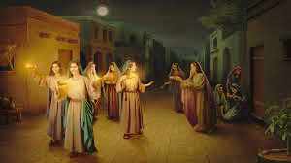
The Parable of the Ten Virgins
Notes:
Chapter 2 begins with the Dream of Nebuchadnezzar.
- A decree went fourth that all the wise should be slain and that included Daniel and some of his people that were wise
Daniel goes into prayer where he finds favour with God to see this dream and the interpretation thereof.
I like the respond of Daniel which everyone should learn of
27. Daniel answered in the presence of the king, and said, The secret which the king hath demanded cannot the wise men, the astrologers, the magicians, the soothsayers, shew unto the king

Slide 5

How I love that parable of the virgin. You know the old coal oil lamps we used to have. I used…We never had lights till just recently. And looky here. The oil’s in the bottom of the lamp. And there’s a wick that draws it up. Now, that wick has to be a special made piece of material. And the fire comes on the end of the wick
58-0202 - ESCAPE HITHER, COME QUICKLY
Notes:
Before we go into scripture let's have a look at what the prophet says to lay the foundation...
6 Now, Daniel was one of the prophet that was carried from Jerusalem, down into Babylon, in the carrying away of Babylon, by King Nebuchadnezzar. He was a young fellow when he went down into Babylon.
3. And the king spake unto Ashpenaz the master of his eunuchs, that he should bring certain of the children of Israel, and of the king's seed, and of the princes;
4. Children in whom was no blemish, but well favoured, and skilful in all wisdom, and cunning in knowledge, and understanding science, and such as had ability in them to stand in the king's palace, and whom they might teach the learning and the tongue of the Chaldeans.

Slide 6
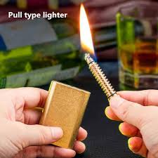
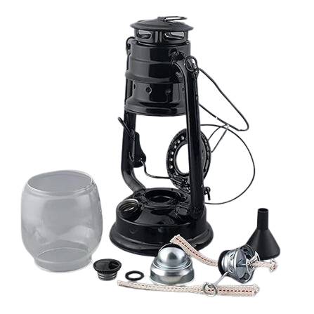
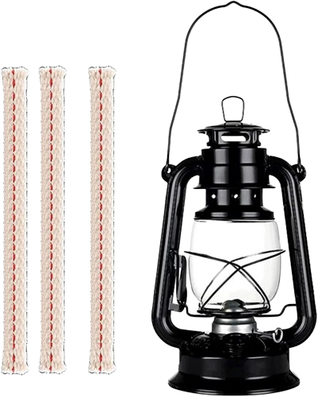
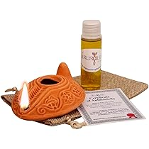
The Lamp
Notes:
Chapter 2 begins with the Dream of Nebuchadnezzar.
- A decree went fourth that all the wise should be slain and that included Daniel and some of his people that were wise
Daniel goes into prayer where he finds favour with God to see this dream and the interpretation thereof.
I like the respond of Daniel which everyone should learn of
27. Daniel answered in the presence of the king, and said, The secret which the king hath demanded cannot the wise men, the astrologers, the magicians, the soothsayers, shew unto the king

Slide 7
And now notice, you couldn’t put a pipe down in there and it would draw it up; it won’t come through iron made, man-made things. It only comes through God’s provided way. And the wick is faith. And the only thing that can pull the Holy Spirit into a Light is the Holy Ghost Itself
58-0202 - ESCAPE HITHER, COME QUICKLY
Notes:
Before we go into scripture let's have a look at what the prophet says to lay the foundation...
6 Now, Daniel was one of the prophet that was carried from Jerusalem, down into Babylon, in the carrying away of Babylon, by King Nebuchadnezzar. He was a young fellow when he went down into Babylon.
3. And the king spake unto Ashpenaz the master of his eunuchs, that he should bring certain of the children of Israel, and of the king's seed, and of the princes;
4. Children in whom was no blemish, but well favoured, and skilful in all wisdom, and cunning in knowledge, and understanding science, and such as had ability in them to stand in the king's palace, and whom they might teach the learning and the tongue of the Chaldeans.

Slide 8
26 Now, we want to speak now upon faith, and a different type of faith: Perfect Faith. That’s a great thing. Now, faith, we’re told in the Bible, “Faith cometh by hearing.” Now, you cannot be saved without faith. And faith is something that you have to believe it’s there, that really nothing else will declare it’s there but faith. Now I’m trying to bring faith to you, so that you can be ready for this prayer line, in the next few minutes
63-0825E - PERFECT FAITH
Notes:
Before we go into scripture let's have a look at what the prophet says to lay the foundation...
6 Now, Daniel was one of the prophet that was carried from Jerusalem, down into Babylon, in the carrying away of Babylon, by King Nebuchadnezzar. He was a young fellow when he went down into Babylon.
3. And the king spake unto Ashpenaz the master of his eunuchs, that he should bring certain of the children of Israel, and of the king's seed, and of the princes;
4. Children in whom was no blemish, but well favoured, and skilful in all wisdom, and cunning in knowledge, and understanding science, and such as had ability in them to stand in the king's palace, and whom they might teach the learning and the tongue of the Chaldeans.

Slide 9
31 Now, listen close! See, it is not what you imagine. It’s just as real to you as any sense of your body will declare anything else. It’s just as real as my eyes says, “This is a piece of paper.” It’s just as real as to say that “that is a light.” It’s just as real as to say, “I feel my coat.” It’s just as real as—as I hear that baby talking there, or making its noise. See, just that real, as music playing. It’s just as real as I taste anything in my mouth. It is that real, only you can’t show it to somebody else. You have it alone. Amen! It’s yours. Faith is the substance; see, not just a myth. So, many people come…
63-0825E - PERFECT FAITH
Notes:
Before we go into scripture let's have a look at what the prophet says to lay the foundation...
6 Now, Daniel was one of the prophet that was carried from Jerusalem, down into Babylon, in the carrying away of Babylon, by King Nebuchadnezzar. He was a young fellow when he went down into Babylon.
3. And the king spake unto Ashpenaz the master of his eunuchs, that he should bring certain of the children of Israel, and of the king's seed, and of the princes;
4. Children in whom was no blemish, but well favoured, and skilful in all wisdom, and cunning in knowledge, and understanding science, and such as had ability in them to stand in the king's palace, and whom they might teach the learning and the tongue of the Chaldeans.

Slide 10
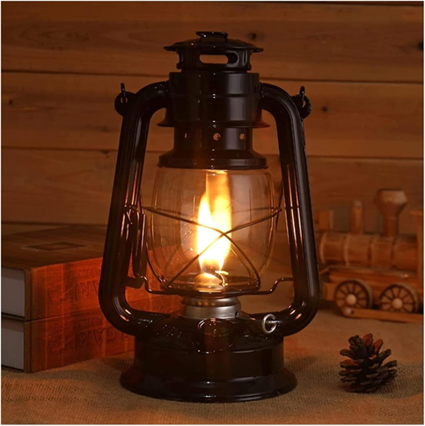
And when you got your faith, one end of it on fire for the glory of God and the other dipped into God’s Holy Ghost oil, there’s going to be a shining Light just as certain as I’m standing in this pulpit. That’s right. ”
58-0202 - ESCAPE HITHER, COME QUICKLY
Notes:
Before we go into scripture let's have a look at what the prophet says to lay the foundation...
6 Now, Daniel was one of the prophet that was carried from Jerusalem, down into Babylon, in the carrying away of Babylon, by King Nebuchadnezzar. He was a young fellow when he went down into Babylon.
3. And the king spake unto Ashpenaz the master of his eunuchs, that he should bring certain of the children of Israel, and of the king's seed, and of the princes;
4. Children in whom was no blemish, but well favoured, and skilful in all wisdom, and cunning in knowledge, and understanding science, and such as had ability in them to stand in the king's palace, and whom they might teach the learning and the tongue of the Chaldeans.

Slide 11
But what if you got it down in oil mixed with water? You know what it’ll do? It’ll sputter. That’s what’s the matter with the lamps today of many. They’re sputtering. It makes carbon over the top of it, and you have to rise and trim your lamps.
58-0202 - ESCAPE HITHER, COME QUICKLY
Notes:
Before we go into scripture let's have a look at what the prophet says to lay the foundation...
6 Now, Daniel was one of the prophet that was carried from Jerusalem, down into Babylon, in the carrying away of Babylon, by King Nebuchadnezzar. He was a young fellow when he went down into Babylon.
3. And the king spake unto Ashpenaz the master of his eunuchs, that he should bring certain of the children of Israel, and of the king's seed, and of the princes;
4. Children in whom was no blemish, but well favoured, and skilful in all wisdom, and cunning in knowledge, and understanding science, and such as had ability in them to stand in the king's palace, and whom they might teach the learning and the tongue of the Chaldeans.

Slide 12
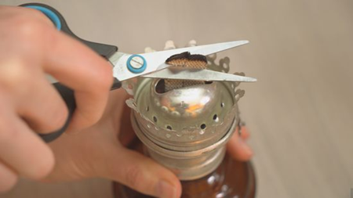
Matthew 25 :7 - 8
7 Then all those virgins arose, and trimmed their lamps
8 And the foolish said unto the wise, Give us of your oil; for our lamps are gone out.
Notes:
Chapter 2 begins with the Dream of Nebuchadnezzar.
- A decree went fourth that all the wise should be slain and that included Daniel and some of his people that were wise
Daniel goes into prayer where he finds favour with God to see this dream and the interpretation thereof.
I like the respond of Daniel which everyone should learn of
27. Daniel answered in the presence of the king, and said, The secret which the king hath demanded cannot the wise men, the astrologers, the magicians, the soothsayers, shew unto the king

Slide 13
And if there ever was a time that lamps ought to be trimmed, is right now. “Hasten, go hither; for I can do nothing till you come thither.”
58-0202 - ESCAPE HITHER, COME QUICKLY
Notes:
Before we go into scripture let's have a look at what the prophet says to lay the foundation...
6 Now, Daniel was one of the prophet that was carried from Jerusalem, down into Babylon, in the carrying away of Babylon, by King Nebuchadnezzar. He was a young fellow when he went down into Babylon.
3. And the king spake unto Ashpenaz the master of his eunuchs, that he should bring certain of the children of Israel, and of the king's seed, and of the princes;
4. Children in whom was no blemish, but well favoured, and skilful in all wisdom, and cunning in knowledge, and understanding science, and such as had ability in them to stand in the king's palace, and whom they might teach the learning and the tongue of the Chaldeans.

Slide 14
Trim off the world; trim off the fashions of the world; trim off the things of the world. Get ready; the hour is at hand.
56 And right when they went to get this, what happened? What taken place? Then the Bridegroom went in
58-0202 - ESCAPE HITHER, COME QUICKLY
Notes:
Before we go into scripture let's have a look at what the prophet says to lay the foundation...
6 Now, Daniel was one of the prophet that was carried from Jerusalem, down into Babylon, in the carrying away of Babylon, by King Nebuchadnezzar. He was a young fellow when he went down into Babylon.
3. And the king spake unto Ashpenaz the master of his eunuchs, that he should bring certain of the children of Israel, and of the king's seed, and of the princes;
4. Children in whom was no blemish, but well favoured, and skilful in all wisdom, and cunning in knowledge, and understanding science, and such as had ability in them to stand in the king's palace, and whom they might teach the learning and the tongue of the Chaldeans.

Slide 15
The wicks got in bad shape. You know that wick is a great thing. I used to watch. What a real wick of God is a believer, is a wick. Look, he’s got a fire on one end, up here, and the other end’s dipped into oil, drawing oil and making fire. What a church, what a power. What a place to be. Hallelujah. Shining that same Gospel light that shines in the east, is shining in the west. It shall be light in the evening time. Rise, trim your lamp, Pentecost.
58-0202 - ESCAPE HITHER, COME QUICKLY
Notes:
Before we go into scripture let's have a look at what the prophet says to lay the foundation...
6 Now, Daniel was one of the prophet that was carried from Jerusalem, down into Babylon, in the carrying away of Babylon, by King Nebuchadnezzar. He was a young fellow when he went down into Babylon.
3. And the king spake unto Ashpenaz the master of his eunuchs, that he should bring certain of the children of Israel, and of the king's seed, and of the princes;
4. Children in whom was no blemish, but well favoured, and skilful in all wisdom, and cunning in knowledge, and understanding science, and such as had ability in them to stand in the king's palace, and whom they might teach the learning and the tongue of the Chaldeans.

Slide 16
“Faith cometh by hearing, and hearing the Word of God.” That puts it back to where your faith, then, is not in some individual. It’s not in a man. It’s not in a organization. It’s not in a group of people. It’s in God, because God is the Word. See? Your faith is in God.
63-0825E - PERFECT FAITH
Notes:
Before we go into scripture let's have a look at what the prophet says to lay the foundation...
6 Now, Daniel was one of the prophet that was carried from Jerusalem, down into Babylon, in the carrying away of Babylon, by King Nebuchadnezzar. He was a young fellow when he went down into Babylon.
3. And the king spake unto Ashpenaz the master of his eunuchs, that he should bring certain of the children of Israel, and of the king's seed, and of the princes;
4. Children in whom was no blemish, but well favoured, and skilful in all wisdom, and cunning in knowledge, and understanding science, and such as had ability in them to stand in the king's palace, and whom they might teach the learning and the tongue of the Chaldeans.

Slide 17
35 Now, you see somebody else do something by a work or act of God, or a promise of God; and many of them say, “I can do that, too.” It’s an imagination. And when they do, you find them wrecked up out there somewhere. It’s got to be a substance.
63-0825E - PERFECT FAITH
Notes:
Before we go into scripture let's have a look at what the prophet says to lay the foundation...
6 Now, Daniel was one of the prophet that was carried from Jerusalem, down into Babylon, in the carrying away of Babylon, by King Nebuchadnezzar. He was a young fellow when he went down into Babylon.
3. And the king spake unto Ashpenaz the master of his eunuchs, that he should bring certain of the children of Israel, and of the king's seed, and of the princes;
4. Children in whom was no blemish, but well favoured, and skilful in all wisdom, and cunning in knowledge, and understanding science, and such as had ability in them to stand in the king's palace, and whom they might teach the learning and the tongue of the Chaldeans.

Slide 18
39 I—I want you to get this now. We…the Church has got to lift Itself in the power of God. How? We are too close to the end, now; and I believe the Church is in condition where we can teach It a little deeper things, and rub some of this make-believe out, see, and get into something real. See? It’s got to be something that you know!
63-0825E - PERFECT FAITH
Notes:
Before we go into scripture let's have a look at what the prophet says to lay the foundation...
6 Now, Daniel was one of the prophet that was carried from Jerusalem, down into Babylon, in the carrying away of Babylon, by King Nebuchadnezzar. He was a young fellow when he went down into Babylon.
3. And the king spake unto Ashpenaz the master of his eunuchs, that he should bring certain of the children of Israel, and of the king's seed, and of the princes;
4. Children in whom was no blemish, but well favoured, and skilful in all wisdom, and cunning in knowledge, and understanding science, and such as had ability in them to stand in the king's palace, and whom they might teach the learning and the tongue of the Chaldeans.

Slide 19
114 And so when a man lives by faith and walks by faith, I mean substance faith, he is isolated from the entire world and becomes a new creature in Christ.
There, now you’re getting into Bride material. See? See? See?
You’re getting into rapturing condition, now. That means for each one of us; not just the pastor, deacons, trustees. That means for the laity, every individual walks in a world with God alone
63-0825E - PERFECT FAITH
Notes:
Before we go into scripture let's have a look at what the prophet says to lay the foundation...
6 Now, Daniel was one of the prophet that was carried from Jerusalem, down into Babylon, in the carrying away of Babylon, by King Nebuchadnezzar. He was a young fellow when he went down into Babylon.
3. And the king spake unto Ashpenaz the master of his eunuchs, that he should bring certain of the children of Israel, and of the king's seed, and of the princes;
4. Children in whom was no blemish, but well favoured, and skilful in all wisdom, and cunning in knowledge, and understanding science, and such as had ability in them to stand in the king's palace, and whom they might teach the learning and the tongue of the Chaldeans.

Slide 20
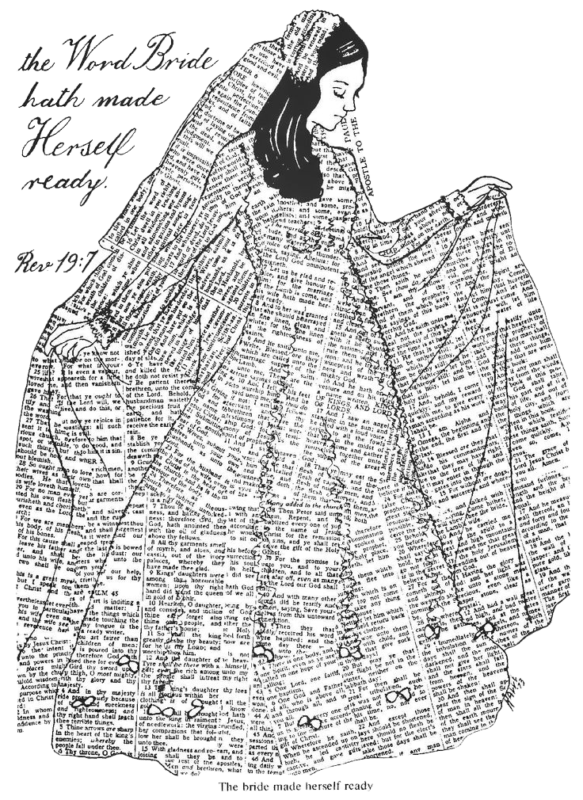
Revelation 19 vs 8
8 And to her was granted that she should be arrayed in fine linen, clean and white: for the fine linen is the righteousness of saints.
Notes:
Chapter 2 begins with the Dream of Nebuchadnezzar.
- A decree went fourth that all the wise should be slain and that included Daniel and some of his people that were wise
Daniel goes into prayer where he finds favour with God to see this dream and the interpretation thereof.
I like the respond of Daniel which everyone should learn of
27. Daniel answered in the presence of the king, and said, The secret which the king hath demanded cannot the wise men, the astrologers, the magicians, the soothsayers, shew unto the king

Slide 21
270 You’re the virtuous Bride of Christ, washed in the Blood of Christ. Precious, virtuous, sinless Son of God standing with a pure, unadulterated Bride-Word that He washed by the Water of His Own Blood; that become flesh and manifested, that He might take you which were predestinated in the bosom of the Father, before the beginning, the same as He was. He was that great attribute of God, called “love.”
65-1125 - THE INVISIBLE UNION OF THE BRIDE OF CHRIST
Notes:
Before we go into scripture let's have a look at what the prophet says to lay the foundation...
6 Now, Daniel was one of the prophet that was carried from Jerusalem, down into Babylon, in the carrying away of Babylon, by King Nebuchadnezzar. He was a young fellow when he went down into Babylon.
3. And the king spake unto Ashpenaz the master of his eunuchs, that he should bring certain of the children of Israel, and of the king's seed, and of the princes;
4. Children in whom was no blemish, but well favoured, and skilful in all wisdom, and cunning in knowledge, and understanding science, and such as had ability in them to stand in the king's palace, and whom they might teach the learning and the tongue of the Chaldeans.

Slide 22
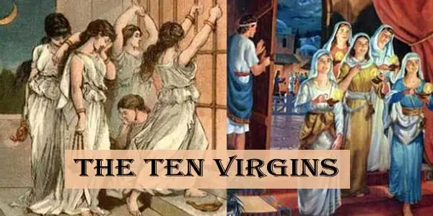
Matthew 25 :7 - 10
10 And while they went to buy, the bridegroom came; and they that were ready went in with him to the marriage: and the door was shut.
Notes:
Chapter 2 begins with the Dream of Nebuchadnezzar.
- A decree went fourth that all the wise should be slain and that included Daniel and some of his people that were wise
Daniel goes into prayer where he finds favour with God to see this dream and the interpretation thereof.
I like the respond of Daniel which everyone should learn of
27. Daniel answered in the presence of the king, and said, The secret which the king hath demanded cannot the wise men, the astrologers, the magicians, the soothsayers, shew unto the king

Slide 23
262 But, you see, that sleeping virgin ain’t receiving nothing, anyhow. Uh-huh. That’s right. And remember, while they went to try to buy Oil, remember, the Scriptures doesn’t say they got It.
263 But while they were out trying to buy It, there come a sound. What happened? All those virgins that slept, rose and trimmed their lamps, “and went in to the Supper.” Is that right?
63-0317E - THE BREACH BETWEEN THE SEVEN CHURCH AGES AND THE SEVEN SEALS
Notes:
Before we go into scripture let's have a look at what the prophet says to lay the foundation...
6 Now, Daniel was one of the prophet that was carried from Jerusalem, down into Babylon, in the carrying away of Babylon, by King Nebuchadnezzar. He was a young fellow when he went down into Babylon.
3. And the king spake unto Ashpenaz the master of his eunuchs, that he should bring certain of the children of Israel, and of the king's seed, and of the princes;
4. Children in whom was no blemish, but well favoured, and skilful in all wisdom, and cunning in knowledge, and understanding science, and such as had ability in them to stand in the king's palace, and whom they might teach the learning and the tongue of the Chaldeans.

Slide 24
264 And the rest was left for the Tribulation period, right, “Weeping, wailing, and gnashing of teeth.” That’s the church, not the Bride; the church.
265 The Bride went in. There is a whole difference between the church and the Bride. Yes, sir! Uh-huh. “Went in to the Wedding Supper.
63-0317E - THE BREACH BETWEEN THE SEVEN CHURCH AGES AND THE SEVEN SEALS
Notes:
Before we go into scripture let's have a look at what the prophet says to lay the foundation...
6 Now, Daniel was one of the prophet that was carried from Jerusalem, down into Babylon, in the carrying away of Babylon, by King Nebuchadnezzar. He was a young fellow when he went down into Babylon.
3. And the king spake unto Ashpenaz the master of his eunuchs, that he should bring certain of the children of Israel, and of the king's seed, and of the princes;
4. Children in whom was no blemish, but well favoured, and skilful in all wisdom, and cunning in knowledge, and understanding science, and such as had ability in them to stand in the king's palace, and whom they might teach the learning and the tongue of the Chaldeans.

Slide 25
Revelation 19 vs 9– 10
9 And he saith unto me, Write, Blessed are they which are called unto the marriage supper of the Lamb. And he saith unto me, These are the true sayings of God
10 And I fell at his feet to worship him. And he said unto me, See thou do it not: I am thy fellowservant, and of thy brethren that have the testimony of Jesus: worship God: for the testimony of Jesus is the spirit of prophecy.
Notes:
Chapter 2 begins with the Dream of Nebuchadnezzar.
- A decree went fourth that all the wise should be slain and that included Daniel and some of his people that were wise
Daniel goes into prayer where he finds favour with God to see this dream and the interpretation thereof.
I like the respond of Daniel which everyone should learn of
27. Daniel answered in the presence of the king, and said, The secret which the king hath demanded cannot the wise men, the astrologers, the magicians, the soothsayers, shew unto the king

